Slide 1
How to use the RSA’s Heritage Index

Slide 2
Contents
Glossary of terms
What is an index?
Understanding how an index is calculated and what we can learn from it
Guide to data tables
A sheet-by-sheet guide to the data included in the downloadable data tables
Using interactive maps
What you can do with the Heritage Index
Finding more information
Where to find the data and report for the Heritage Index

Slide 3
1 Glossary of terms

Slide 4
Glossary of terms
Heritage Index rank |  | Heritage Potential rank
The rank is the position of each local authority's Heritage Index score when listed from highest to lowest. The local authority ranked in 1st position has the highest Heritage Index score, for example. |  | Calculated as the difference in heritage assets ranking and heritage activities ranking. This is the opportunity within the Heritage Index to utilise assets.
Assets |  | Activities
Historic England define heritage assets as ‘a building, monument, site, place, area or landscape identified as having a degree of significance meriting consideration in planning decisions, because of its heritage interest. |  | Heritage activities include a breadth of ways that local areas engage with tangible and intangible heritage assets. They span funding, volunteering, visiting heritage locations and other types of engagement.
Heritage domains
Heritage domains are how the Heritage Index categorises heritage, based on National Lottery Heritage Fund interest areas. Each of the six named domain makes up 15% of the final Heritage Index score, and a general domain makes up the final 10%.

Slide 5
2 What is an index?

Slide 6
What is an index?
An index is not an exact science and instead is an attempt to make a best assessment of some otherwise immeasurable concept. In the case of the Heritage Index, a number of quantifiable aspects of heritage are combined to create a single summary score. The ranking of these scores is the final Heritage Index ranking.
It is not possible to count all aspects of heritage and so the Heritage Index calculation process requires decisions to be made about the data – what variables and factors should be included, and how should they be weights are just some of the considerations that are made.
The Heritage Index ranking is most useful as a relative measure; how does one local area compare to another, or how does the performance of one local authority in one domain compare to it’s performance in another domain?
A full technical report can be found on the RSA website.

Slide 7
3 Guide to data tables

Slide 8
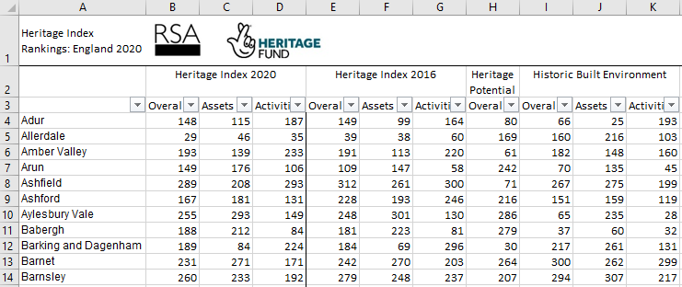
a. Heritage Index Rankings 2020
This table includes all the rankings and sub rankings. That is:
Overall Heritage Index 2020 ranking, including for assets and activities alone
Overall Heritage Index 2016 ranking, including for assets and activities alone (note that this is for comparison purposes but there are some methodological changes that are outlined in the technical appendix for this data)
Heritage Potential ranking
Domain level Heritage Index ranking, including for assets and activities alone
To list local authorities in order of a particular index, highlight all the data and sort by the ranking you’re interest in.
Note: Ranking 1st in the Heritage Index means the local authority has the most assets & activities. Ranking 1st in heritage potential means there is the biggest gap between assets and activities rankings.

Slide 9
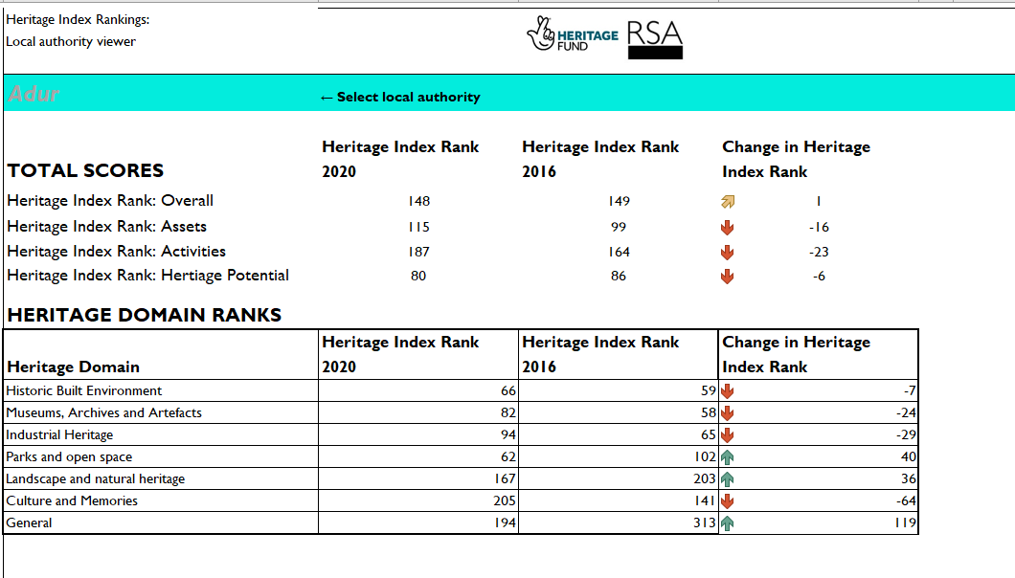
b. Local authority dashboard
This tab includes all the data on a single local authority.
Once selected, the ranking of this local authority (overall, for assets and activities, by domain and heritage potential) for this year’s Heritage Index and the last iteration, 2016.
Select the local authority you are interested in from the dropdown menu.
The arrows show the direction of change over time.
Note: for heritage potential, an increase in ranking (e.g. from 5 to 10) represents an improvement in utilising potential.

Slide 10
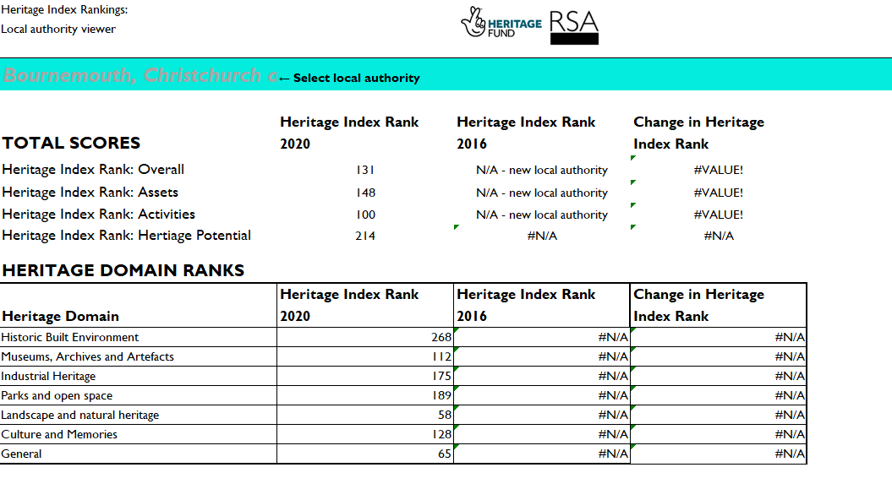
b. Local authority dashboard
This tab includes all the data on a single local authority.
Once selected, the ranking of this local authority (overall, for assets and activities, by domain and heritage potential) for this year’s Heritage Index and the last iteration, 2016.
Note: for local authorities that have new boundaries since the last iteration of the Heritage Index it is not possible to make year on year comparisons. These local authorities will have missing data.

Slide 11
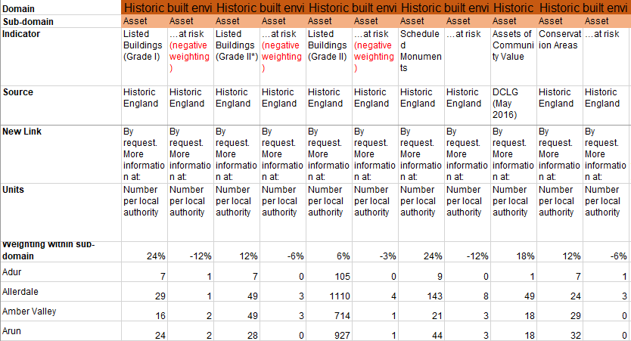
c. Raw data
This tab includes all the raw data collected for the Heritage Index. This data is used to calculate the final Heritage Index rankings. The data includes the name of the data provider, a link to more information, the units of data and the domain in which the data is used in the Heritage Index.
Information about how the variable is categorised and its source is included at the top of the table.
Weighting within sub-domain shows how much this variable contributes to the ranking for either assets or activities in the given domain.
Data is included for each local authority, listed alphabetically.

Slide 12
4 Using interactive maps

Slide 13
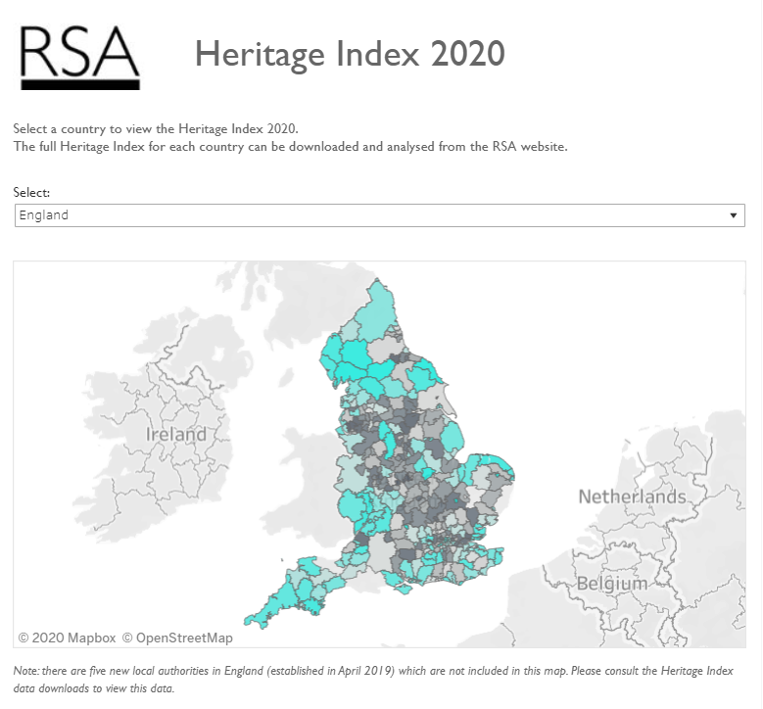
a. Interactive maps
Choose which nation’s data to look at here
Local authorities are colour coded according to their overall Heritage Index ranking.
Turquoise – higher ranking
Grey – lower ranking
Click on a local authority to see their data:

Slide 14
5 What you can do with the Heritage Index

Slide 15
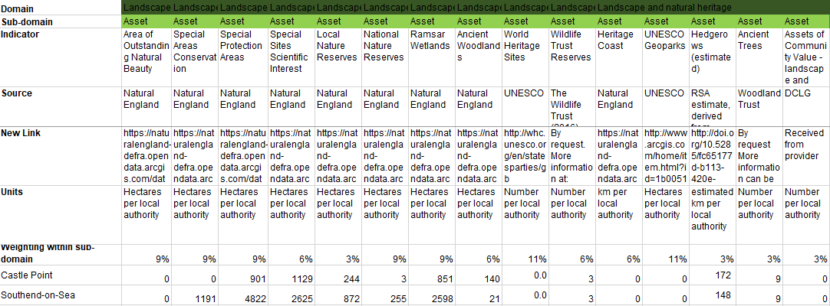
a. Understanding your local area
You can use the Heritage Index to find out more about heritage in your local area.
Why not look up your local area in the ‘Local authority dashboard’ to find which domain(s) it performs well on, and then dig into the raw data to see why it does so well?
Or compare it to nearby locations?

Slide 16
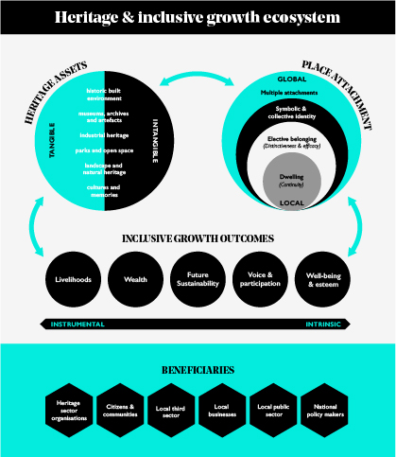
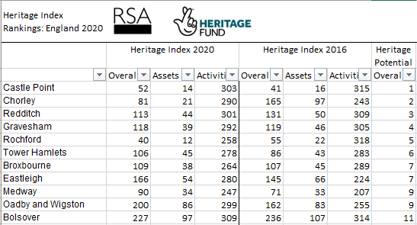
b. Identifying areas with heritage potential
Areas with heritage potential rank higher on their heritage assets than their activities. These are areas where there might be opportunities to increase activity and participation.
You could use the Heritage Index to identify areas with heritage potential, and consider how to utilise this potential in an inclusive way by looking to the RSA’s heritage and inclusive growth ecosystem.

Slide 17
6 Finding more information

Slide 18
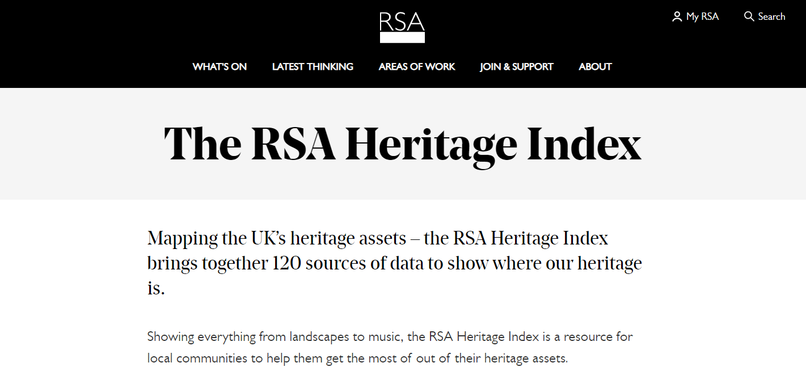
Finding more information
Visit the RSA website to access all the data from this year’s Heritage Index as well as our reports and related work.
Here you can find previous iterations of the Heritage Index too.
And visit our partners, the National Lottery Heritage Fund, to find out more about heritage funding in your area.

